Slide 1
Chat Server Design
© Sony Mobile Communications

Slide 2
Vision
Initialize draft by Jiang, Zhen

Slide 3
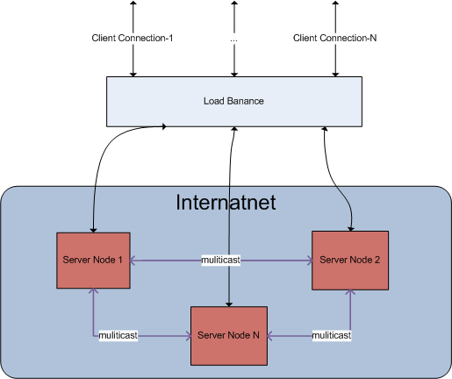
Architecture

Slide 4
Architecture Feature
Cluster servers
Support large clients
Use Load Balance for decrease service node pressure.
High performance for message forward
Easy to extend server nodes
Do not support failover, because need client supports
Only Support IPV4
High extensibility
Server upgrade at runtime
Sync Message in server nodes

Slide 5
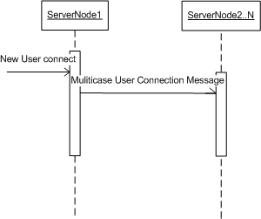
Server Node Forward Policy
Case new user connect to one of server node

Slide 6
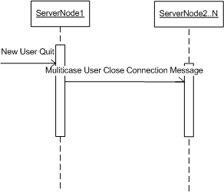
Server Node Forward Policy
Case user disconnect from one of server node

Slide 7
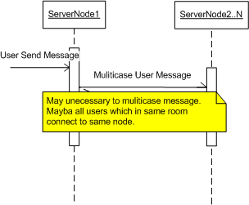
Server Node Forward Policy
Case user send message

Slide 8
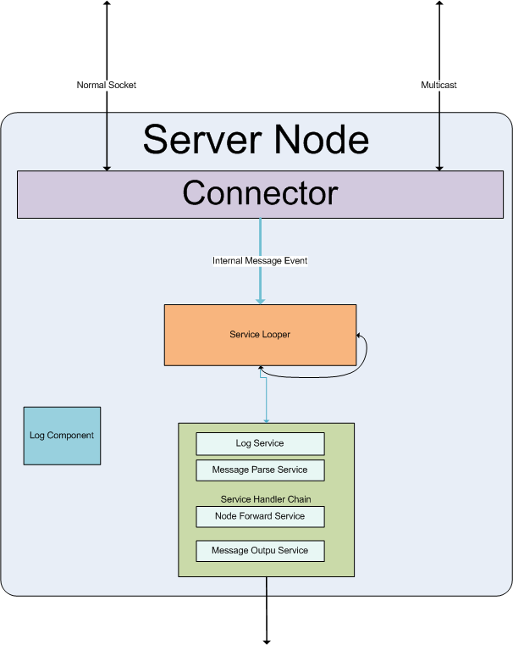
Server Node internal Architecture

Slide 9
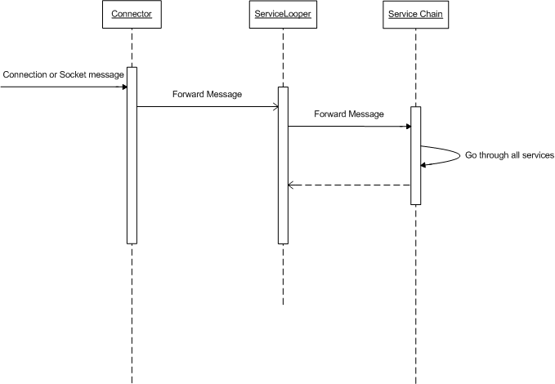
Server Node Internal Sequence

Slide 10
Server Node Connector
Use to listen socket or receive outer message
receive all incoming message
Socket connection message
Normal business socket message
Use NIO selection
Forward message to Service Looper

Slide 11
Server Node Service Lopper
Use to handle all message:
Out socket message
Internal forward message
Output room broadcast message
Output private message

Slide 12
Server Node Service Chain
Make chain for message handle
Any message will go through all links in the chain by order
High extensibility for special feature.
Current service feature:
Log service
Message parse Service
Multicast forward Service
Output Message Service

Slide 13
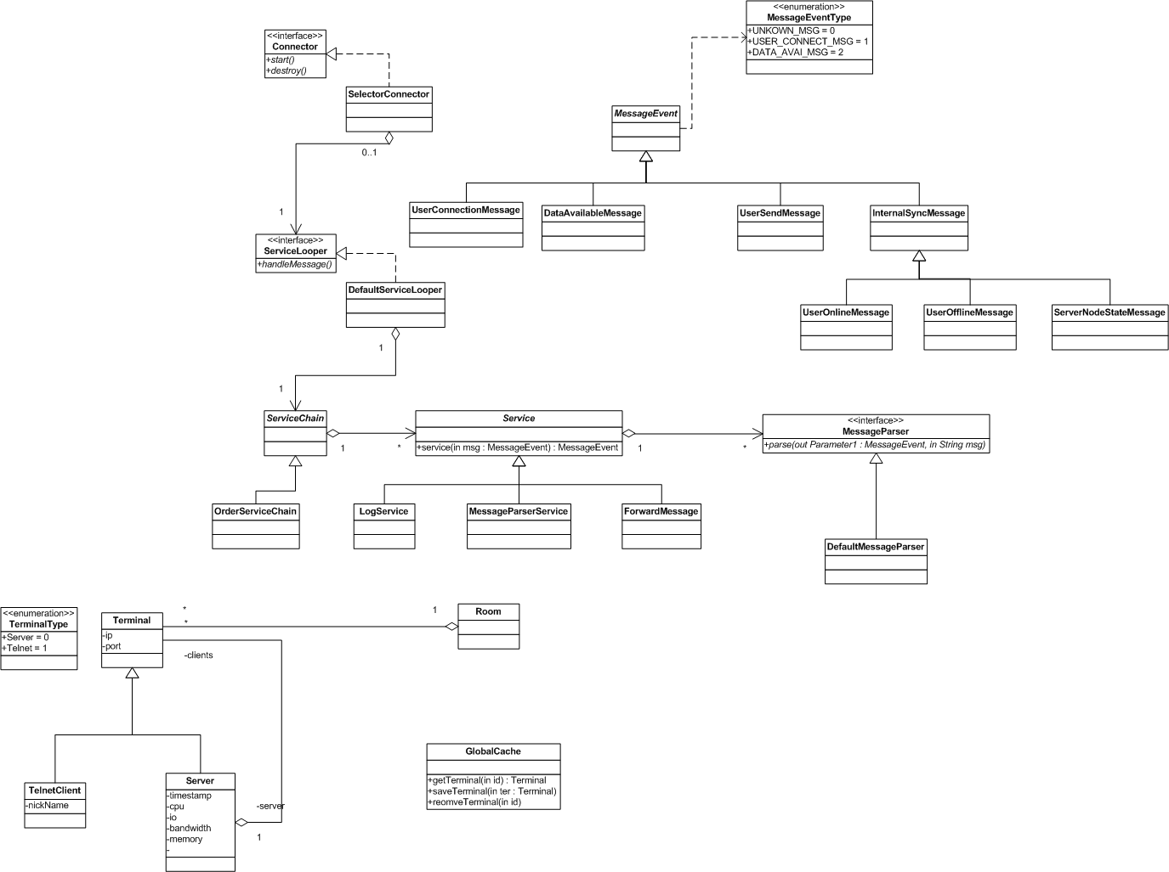
Server Node Static Class Diagram

